Slide 1
Supplemental Linear Regression Lecture
By Elyce Buell

Slide 2
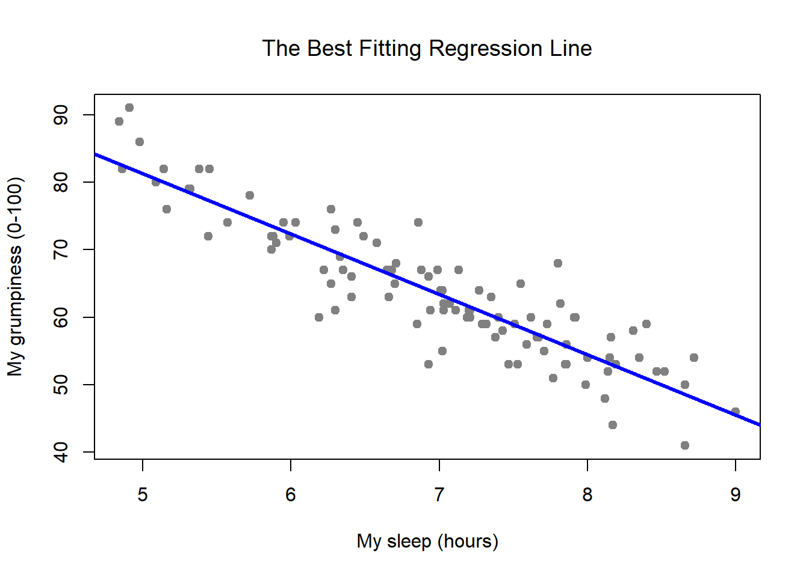
Linear Regression Goal:
Relate something (predictor aka x variable) to something else (response aka y variable)

Slide 3
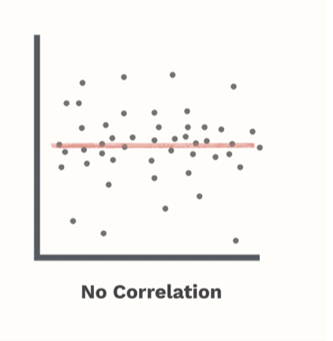
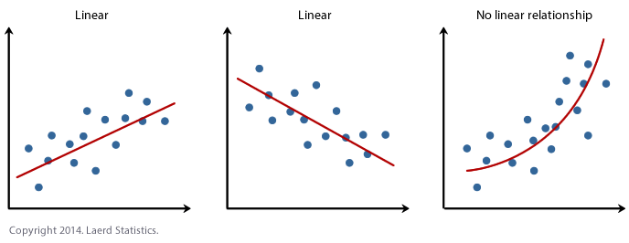
Regression Options
Positive linear
Negative linear
Positive nonlinear
Negative nonlinear
No relationship

Slide 4
Steps to Regression
Data exploration
Visualize data
Introduce information that you know
Outliers
Fit a tentative very simple model
Look at residuals
Look at resulting coefficients and stats on those coefficients
Iterate steps 2 and 3 until you have satisfied all assumptions AND agree with what that linear regression model is proposing
Change model inputs by:
Considering transformations
Adding additional information (additional prediction variables?)

Slide 5
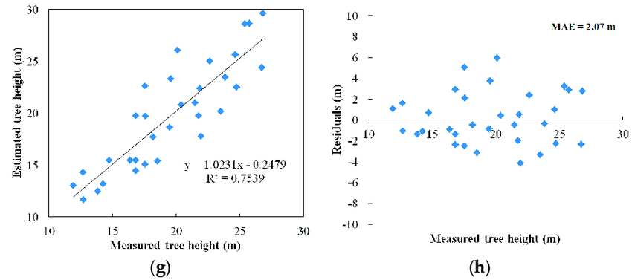
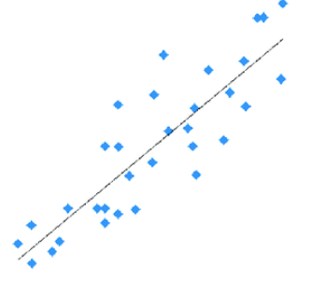
Residuals

Slide 6
Regression Assumptions
Residuals:
Constant variance (homoscedasticity)
Normally distributed
Independant

Slide 7
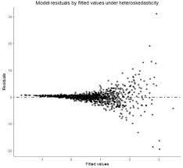
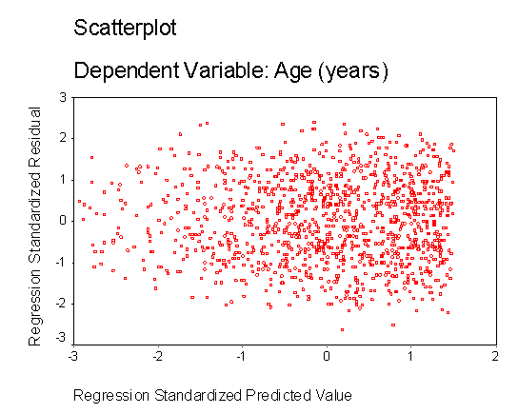
Regression Assumptions: Constant Variance

Slide 8
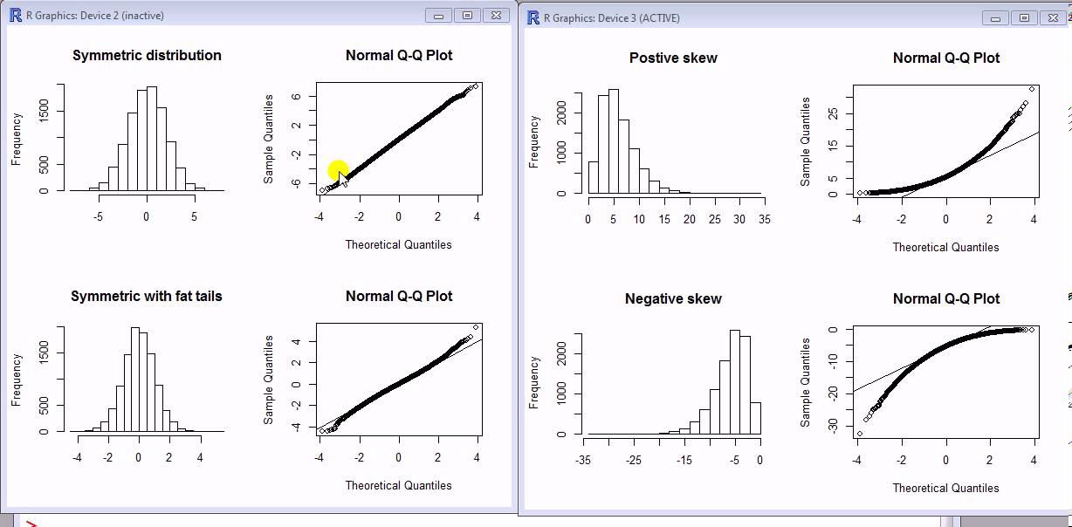
Regression Assumptions: Normally Distributed

Slide 9
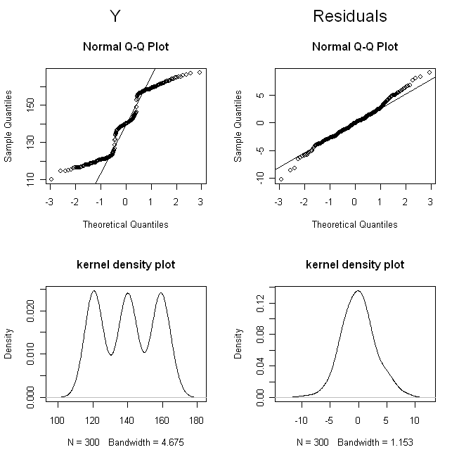
Regression Assumptions: Normally Distributed

Slide 10
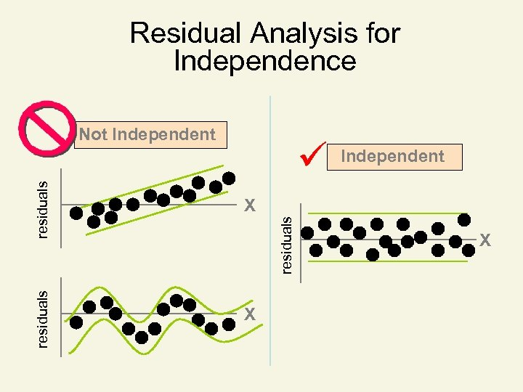
Regression Assumptions: Independant

Slide 11
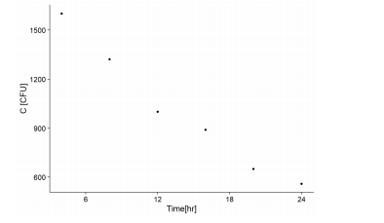
Bacteria Count HW Question
Data exploration

Slide 12
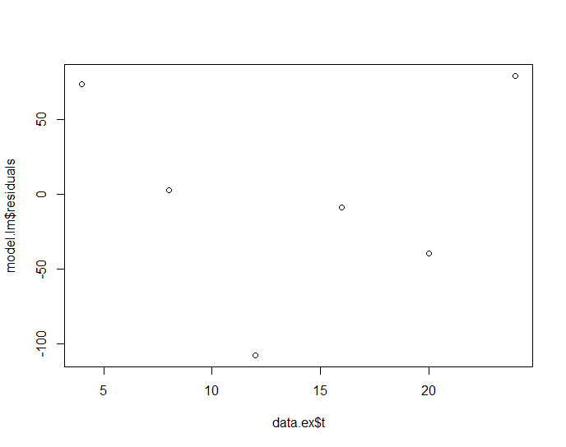
Bacteria Count HW Question
Remember:
Check assumptions on residuals
Constant Variance
Independant
Code: plot(data.ex$t,model.lm$residuals)

Slide 13
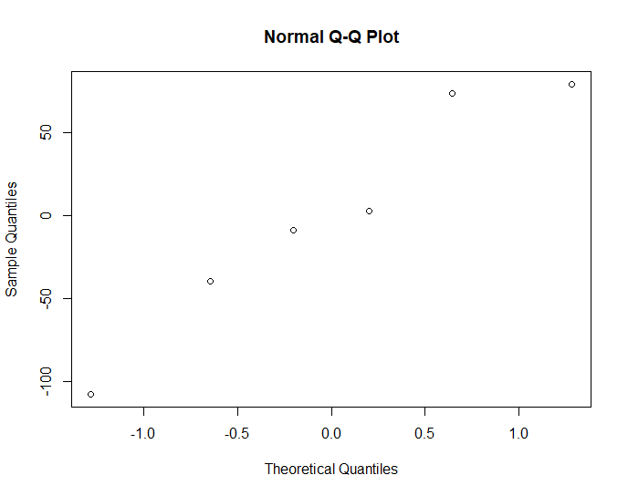
Bacteria Count HW Question
Remember:
Check assumptions on residuals
Normally Distributed
Code: qqnorm(model.lm$residuals)

Slide 14
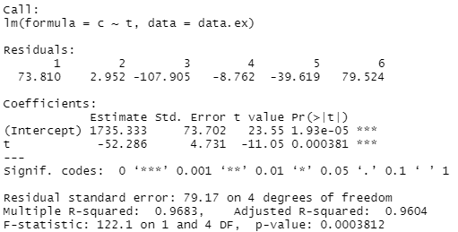
Bacteria Count HW Question
Look at resulting coefficients

Slide 15
Bacteria Count HW Question
Look at resulting coefficients - background
These stats on coefficients are assuming that the user wants to say this:
Intercept is significantly different than zero
Slope is significantly different than zero

Slide 16
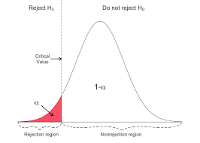
Bacteria Count HW Question
Look at resulting coefficients - background
Notes:
Ho is null hypothesis
Want to reject Ho
In this picture alpha is p
Critical value is t

Slide 17
Bacteria Count HW Question
Look at resulting coefficients

Slide 18
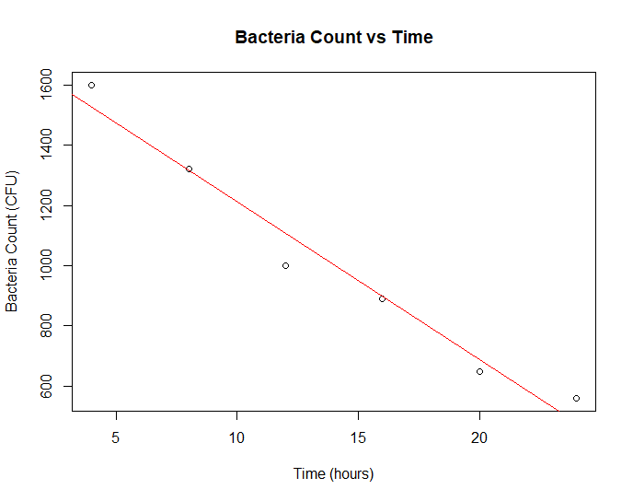
Bacteria Count HW Question
In my opinion, you would be satisfied with your model selection now and would proceed to whatever analysis you were going to do (confidence intervals?, solving for a particular point?, etc.)
Code for plot:
> plot(data.ex$t,data.ex$c,xlab = "Time (hours)", ylab = "Bacteria Count (CFU)", main = "Bacteria Count vs Time")
> abline(a = as.numeric(model.lm$coefficients[1]),b = as.numeric(model.lm$coefficients[2]))

Slide 19
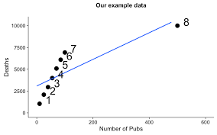
Big NOs:
Do not transform because you are chasing a good R value
Transform if there is a scientific reason to do so or you residuals are not satisfying linear regression assumptions
Do not throw out outlier for no reason

